Slide 1
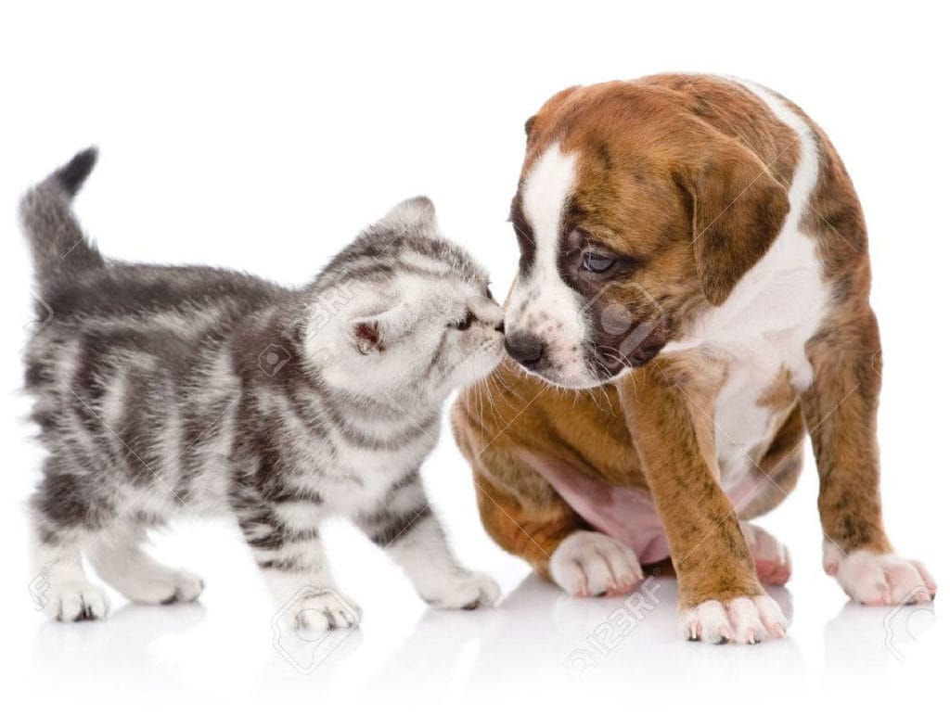
Project Name: Happy Pet
Project Member:
Kiran Kittur (TL) Sayali Chavan
(210543181029) (2105431810)
Pranav Kolle Kalpesh Desale
(210543181044) (210543181035)

Slide 2
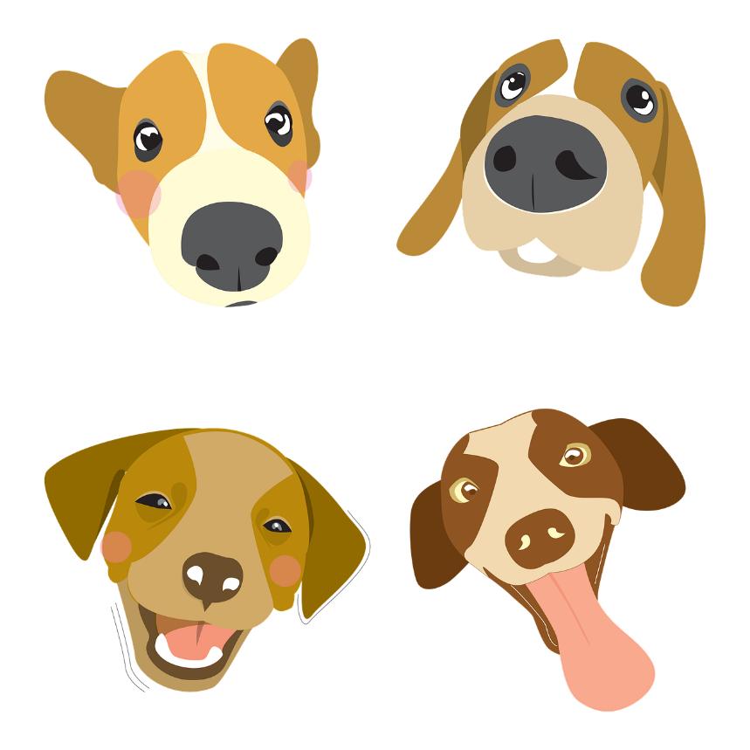
Content
Abstract
Introduction
Objectives
Problem Statement
Advantages Of Systems
Applications
Technologies Used
Use case Digram
Entity Relationship Diagram
Future Scope
Conclusion

Slide 3
Abstract
“An animal has not much mind than the human, but they have a loving heart and loyalty.”
Pet keeping is a common part of many cultures. Humans have been sharing their lives with animals from time immemorial. According to research, pets can have a profound effect on us. Interacting with a pet that behaves properly can have a positive effect on you and the people around you.

Slide 4
Introduction
we are designing a platform for all the animals and animal lover. One can buy and sell the pet online in trusted hand. For the homeless animals, we can click a picture and
post our site so nearby animal shelter will take care of those animals. Animal Lovers can also share their feeling, opinion and advice. Doctor and trainer contact are also been provided to take care of their pet.

Slide 5
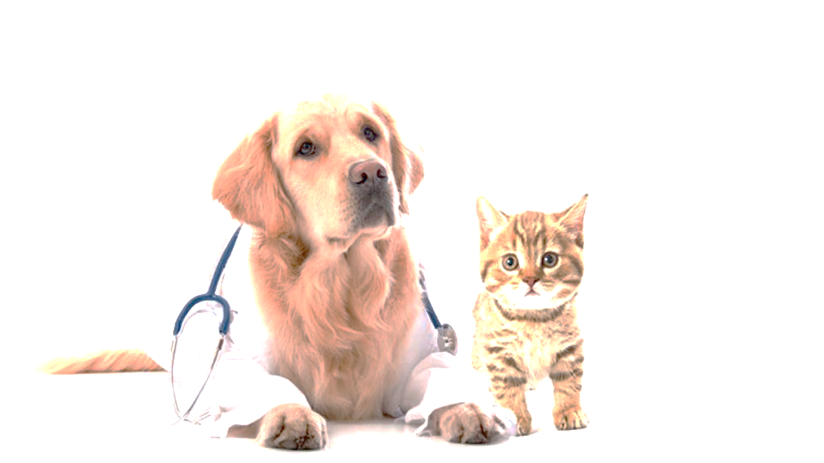
Objectives
Providing a simple web application for Pet Lovers
Buy and Sell a pet.
Can search Pet caretaker.
Can search pet Trainer .
Can search Animal shelter.
Make easy contact to Pet veterinary

Slide 6
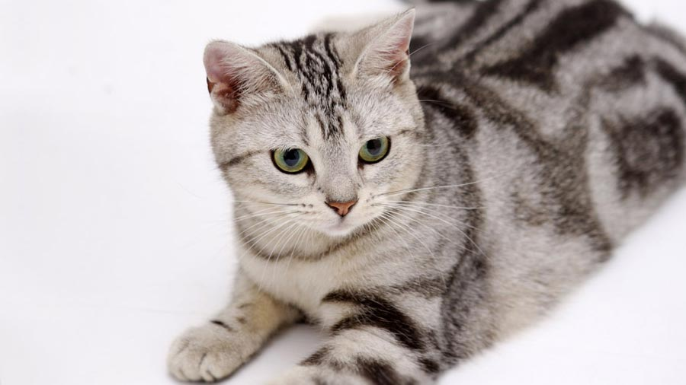
Problem Statement
With the growing society there so many abounded Animals are there On one is looking for them and there is no platform for Pet lovers.
it is necessary to develop a application that gives all in one services in single platform so those who needs the pet care ,animal shelter,Pet veterinary, and platform for Pet Lovers who want to buy and sell there pets

Slide 7
Advantages Of Systems
All pets related thing are available in single platform .
The Pet Lovers can Sell and Buy The Pet from our application .
Provides various services(veterinary,pet caretaker,trainer) one pet can get
Street & abandoned animals will get help & support from animal shelter

Slide 8
Applications
Buy and selling a pet .
Having different service for pets like Pet care, Pet veterinary, Pet trainer, Animal shelter

Slide 9
Technologies Used:-
MySQL
Hibernate
ReactJs

Slide 10

MySQL
MySQL, the most popular Open Source SQL database management system, is developed, distributed, and supported by Oracle Corporation.
Features of MySQL:
Software is Open Source.
Server works in client/server or embedded systems.
Database Server is very fast, reliable, scalable, and easy to use.

Slide 11
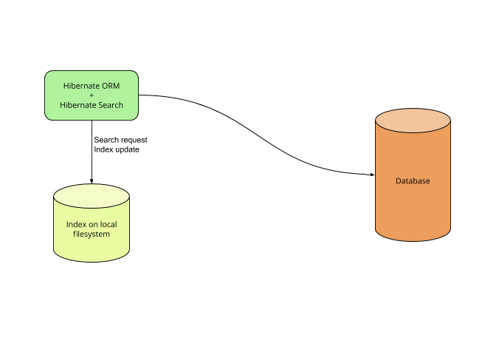
Features of MySQL:
Open Source and Lightweight
Fast Performance
Database Independent Query
Automatic Table Creation
Simplifies Complex Join

Slide 12

Hibernate
Hibernate is an object–relational mapping tool for the Java programming language.
It provides a framework for mapping an object-oriented domain model to a relational database.
Hibernate handles object–relational impedance mismatch problems by replacing direct, persistent database accesses with high-level object handling functions.

Slide 13
ReactJs
React (also known as React.js or ReactJS) is a free and open-source front-end JavaScript library for building user interfaces or UI components. It is maintained by Facebook and a community of individual developers and companies.
React can be used as a base in the development of single-page or mobile applications.

Slide 14
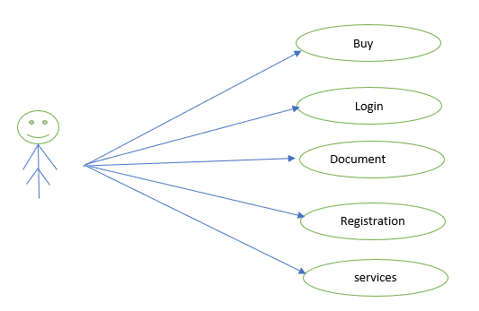
Use Case Diagram
Use Case flow Diagram (Buy):

Slide 15
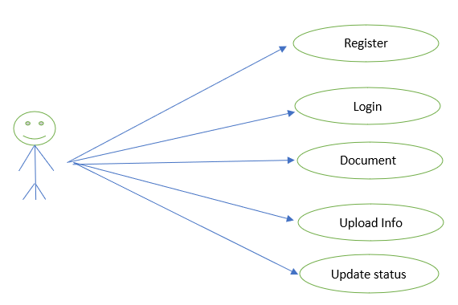
Use Case Diagram
Use Case flow Diagram (Seller):

Slide 16
Entity Relationship Diagram
User Registration:
First Name
Last Name
Name
userID
Phone
User Registration
Email
Pet name
Pet name
breed
type
Age group
color

Slide 17
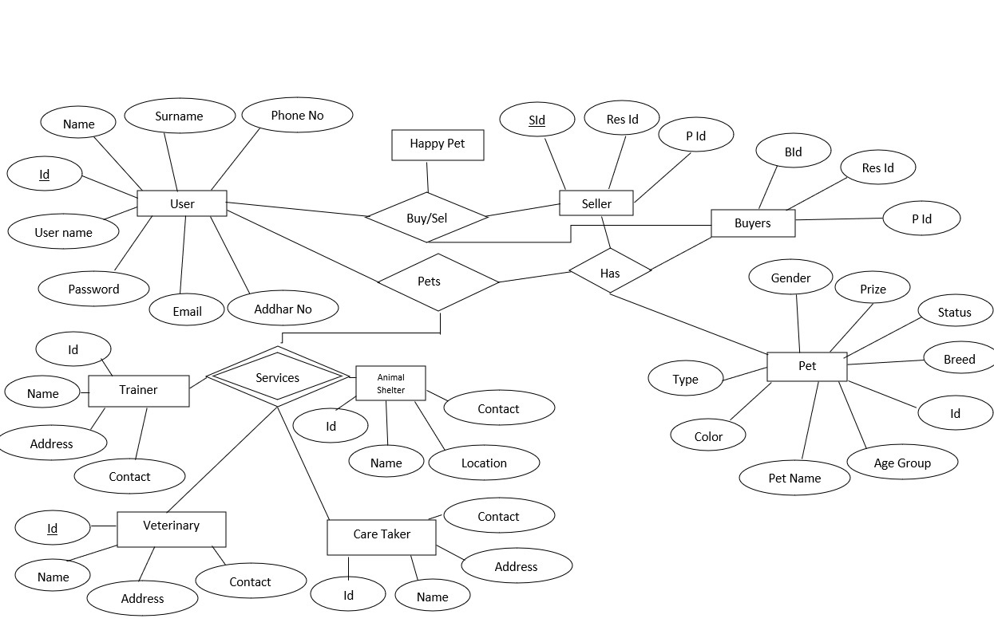
ER Details:

Slide 18
Future Scope
Pet related stuff such as toys,food.
Vaccination appointments
Filters

Slide 19
Conclusion
As conclusion, the objective of pet adoption system have been achieved.
This platform are also available for public to adapt pets or animal which available in any organization listed in the platform. this will enhance their interest to adopt because there will be various kind of animal with various breed from different organization

Slide 20
Thank You!

